Slide 1
Cloud Computing
Liang Hu
School of Software
Notes:
Hello everyone, I’m Hu Liang coming from School of Software. Today, I’ll give a brief introduction about cloud computing

Slide 2
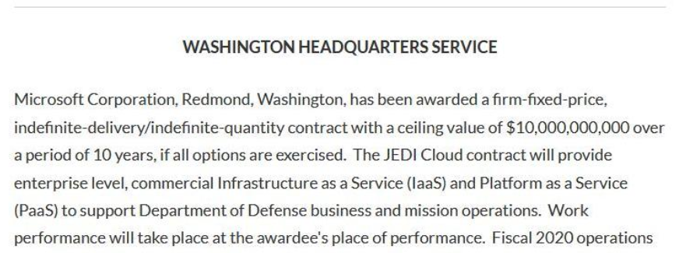
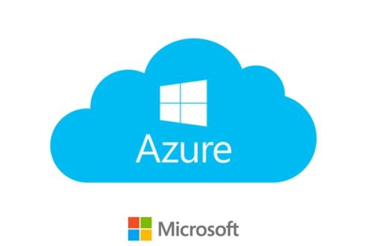
Notes:
So, lets first look at a news published just a few days ago.
America’s Department of Defense reach a contract about 10 billions with Microsoft to provide cloud service in next decade.
10 billion dollars is really a large amount.

Slide 3

What is Cloud Computing?
Remote
Centralization
Cost Transfer
A
B
Notes:
So, now we may want to know what is cloud computing indeed.
the client of Cloud Computing is most company, organization, institute and so on, not for person.
Naturally, we consider cloud computing as a service provider, it provides a set of resources including hardware and software so we just focus on the core of our business.
In company perspective, it means they are launching their service on a cluster of computers hosted in a specialized cloud computing company.
Not every company maintain their own machines respectively, but one company organize all physical machines for every company.
So, we can see three main features of cloud computing showed in page. That is remote, centralization and cost transfer.

Slide 4
Main Cloud Computing Service Provider
Amazon Web Service
Microsoft Azure
Ali Cloud
Tencent Cloud
Huawei Could
Notes:
Here is some main cloud computing service providers
Such as……….

Slide 5
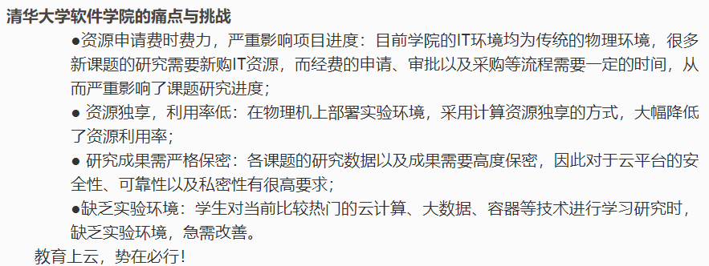
Example
School of Software in Tsinghua University “When education facing cloud”
Notes:
And this is an example in Tsinghua using cloud computing.
The first challenge is the appliance for approval
The second is resource utilization
The third is secret
The last is lack of environment
So, in 2017, School of Software make a decision to use cloud computing in daily office work and study work.
From the above, we can know that cloud computing is a trend in the future, thus we can start to understand a little information about cloud computing.

Slide 6
Thank U !
Notes:
Thank u ~

